Slide 1


INDUSTRIAL TRAINING AND INTERNSHIP
Department of Computer Science & Engineering
C. V. RAMAN GLOBAL UNIVERSITY,
BHUBANESWAR, ODISHA
Submitted by:
Sushobhan Roy
(2101020797)
8th Semester/CSE(DS)

Slide 2
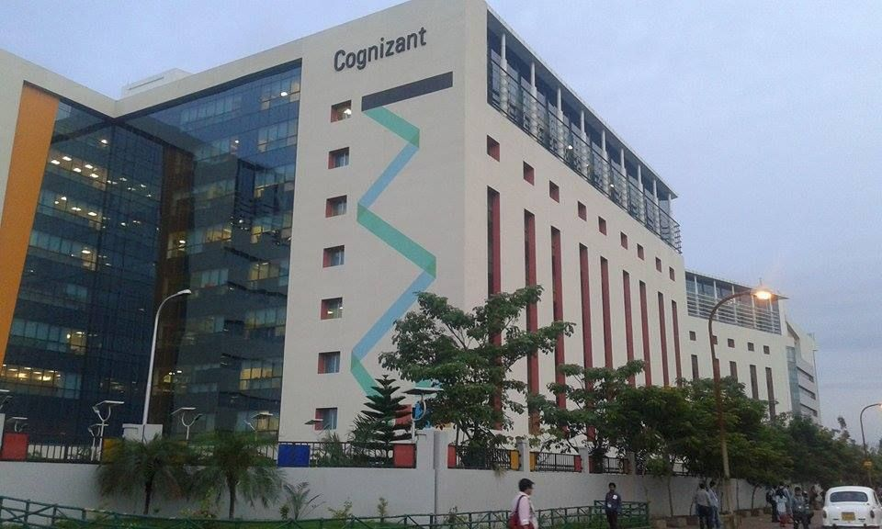
INTRODUCTION
Duration: 3 Months
Training Focus: Cognizant Technology Solutions Gen-C Internship & Training(Java Full Stack Engineering)
Opportunity Through: College Campus Recruitment
Program Highlights:
Structured Learning Path: Divided into distinct stages focusing on key aspects of Full Stack Development.
Mentorship: Guidance from experienced mentors and Subject Matter Experts (SMEs).
Project-Based Learning: Emphasis on real-world projects to apply learned concepts.
Continuous Evaluation: Interim and final assessments to ensure skill acquisition.

Slide 3
TRAINING STAGES
Stage 1 : Onboarding and Brush-up Phase | Stage 2 : Backend Development Phase
Stage 3 : Frontend Development Phase | Stage 4 : Project Evaluation and Deployment Phase

Slide 4
Stage 1 : Onboarding and Brush-up Phase
Activities:
Corporate Induction
Asset Allocation
Core Values Sessions
Leader Talks
Brush up of the basic java concepts
Objective: Familiarize interns with the corporate environment and refresh foundational knowledge.
Duration : 2 weeks

Slide 5
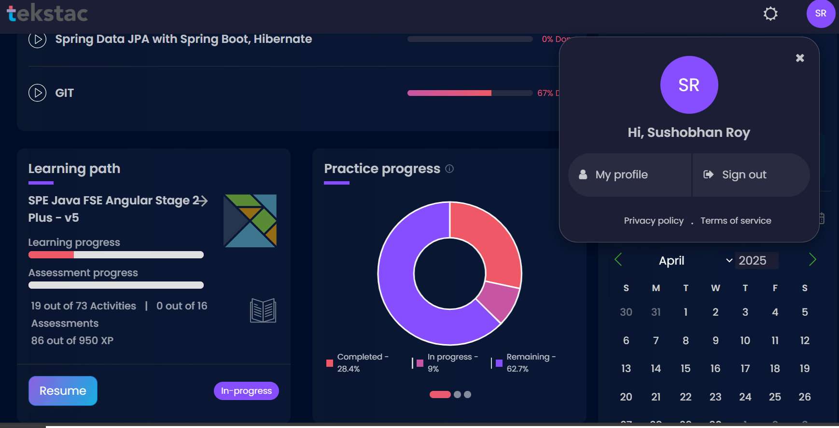
Stage 2 : Backend Development Phase
Focus Areas:
Agile Methodology: Understanding Agile principles and practices.
SOLID Principles: Learning best practices for software design.
Spring Core and Maven: Mastering Spring Framework and project management with Maven.
Test-Driven Development (TDD): Implementing TDD using JUnit and Mockito.
Code Quality: Maintaining high code standards using tools like SonarQube.
Objective: Build a strong foundation in backend development and best practices.
Duration: 1 month.

Slide 6
Stage 3 : Frontend Development Phase
Focus Areas:
Angular (v16): Developing dynamic web applications using Angular.
Docker Basics: Understanding containerization and Docker.
Cloud and DevOps Basics: Leveraging GCP for cloud and DevOps practices.
Application Debugging: Techniques for debugging frontend applications.
Objective: Equip interns with skills to develop and debug frontend applications.
Duration: 1 month

Slide 7
Stage 4 : Project Evaluation and Deployment Phase
Interim Evaluation:
Components: Technical skills assessment and project progress review.
Final Evaluation:
Components: Comprehensive assessment covering all skills learned.
Objective: Ensure readiness for professional challenges through continuous assessment.
Duration: 2 weeks

Slide 8
PROJECT
Project: Employee Leave and Attendance Management System
Introduction
This project outlines the Low-Level Design (LLD) for an Employee Leave and Attendance Management System. The system automates tracking employee attendance, managing leave requests, and calculating working hours. It supports backend development using Java (Spring Boot) and .NET (ASP.NET Core).
Module Overview
Employee Attendance Module: Employees can mark attendance, view attendance history, and track daily clock-in and clock-out times.
Leave Management Module: Employees can request various types of leave (sick leave, vacation, etc.) and track the status of their requests.
Leave Balance Module: Tracks and updates leave balances based on company policies.
Shift Management Module: Assigns shifts to employees based on scheduling needs.
Reports and Analytics Module: Generates reports on attendance trends, leave usage, and shift coverage.

Slide 9
ARCHITECTURE OVERVIEW
Backend Summary
Technology: Spring Boot
Database: Relational Database (MySQL)
API Architecture: REST API
Key Modules:
Employee Attendance: Clock in/out, real-time records, manager dashboard.
Leave Management: Request leave, manager approval/rejection.
Leave Balance: Track and update balances, automatic adjustments.
Shift Management: Assign/manage shifts, view/swap shifts.
Reports and Analytics: Generate reports, provide insights.
Component Interaction:
Frontend communicates with backend via REST APIs.
Backend handles business logic and database interactions.

Slide 10
contd.
Frontend Summary
Technology: Angular
Key Features:
Employee Interface: Mark attendance, request leave, view history, view/swap shifts.
Manager Interface: Monitor attendance, approve/reject leave, manage shifts, access reports.
User Interface:
Attendance dashboard, leave requests, shift schedule.
Interaction:
Communicates with backend via REST APIs for data processing and storage.

Slide 11
CONCLUSION
I am currently in the process of completing my internship at Cognizant, where I am receiving extensive training as a Java Full Stack Engineer. This hands-on experience is allowing me to deepen my understanding of both frontend and backend technologies. I am actively working on the Employee Leave and Attendance Management System project, utilizing Angular for the frontend and Spring Boot for the backend. This project is enhancing my skills in developing dynamic user interfaces, creating RESTful APIs, and managing relational databases. The internship is providing me with valuable practical experience and is preparing me for future challenges in the field of full stack development

